Slide 1

Human Pose Detection
Submitted by- Aditya Pandey(181500043)
Devansh Pandey(181500212)
Mukul Joshi(181500399)
Supervised By- Ms. Priya Agarwal
Technical Trainer

Slide 2
Outline
Introduction
Traditional Approaches
Deep Learning Methods
- Global view(holistic view)
- Local appearance
- Combination of local appearances and global view
- Others

Slide 3
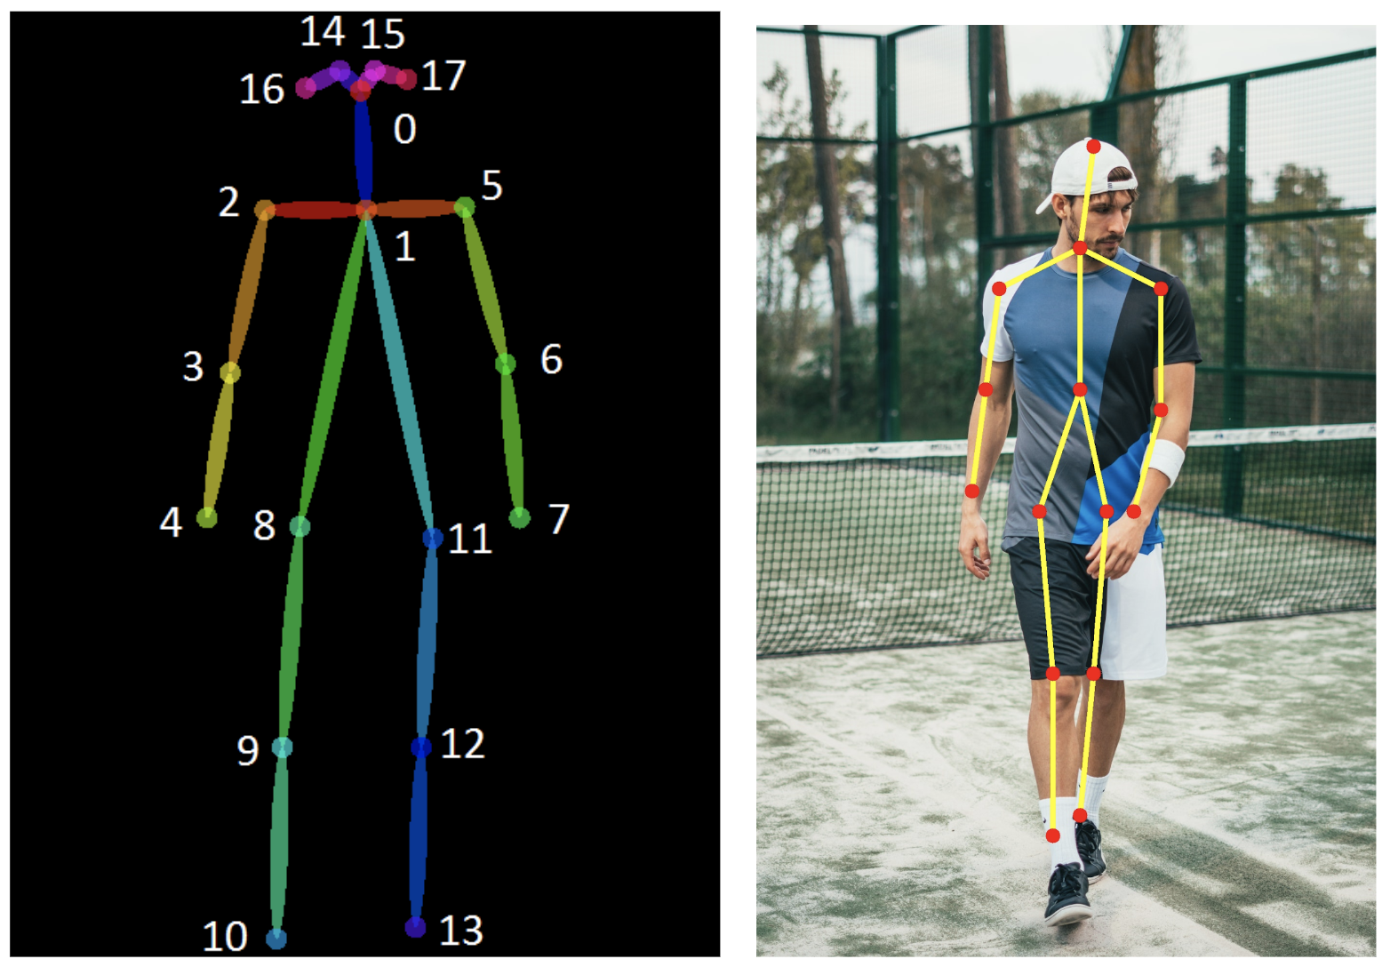
Introduction
What is articulated body pose estimation?
Recovers the pose of an articulated body, which consists of joints and rigid parts using image-based observations.

Slide 4
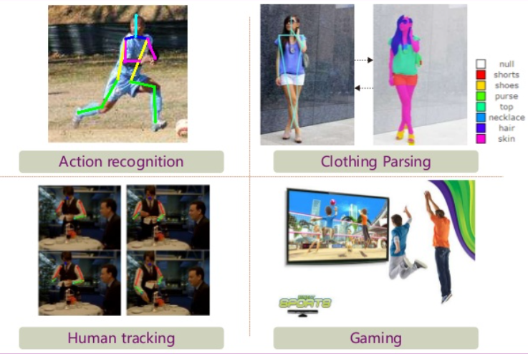
Applications

Slide 5
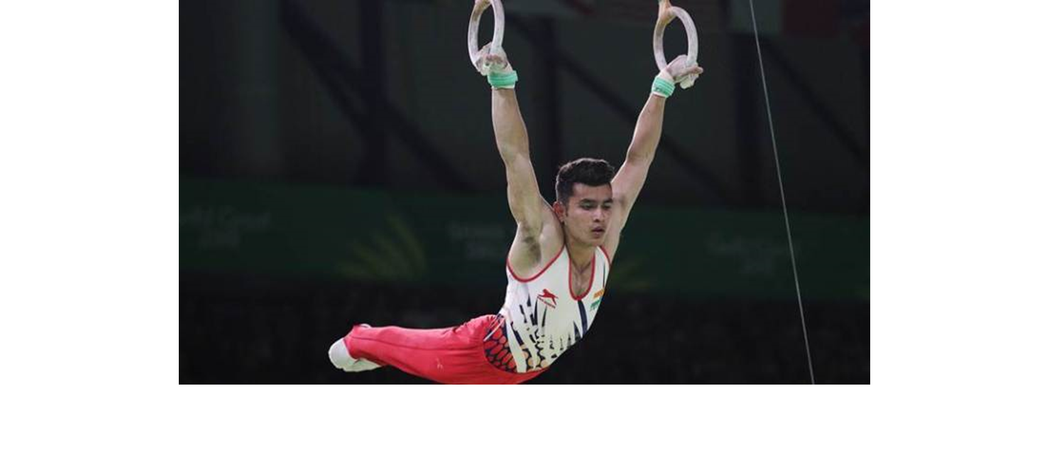
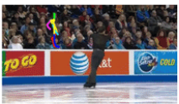
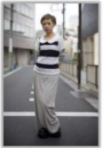
Challenges

Slide 6
Holistic View
e.g. joints position regression
Local View
e.g. body parts detection
Combining global and local information
e.g. body parts detection + joints position regression
Others
- e.g. motion features, pose estimation in videos

Slide 7
Why holistic Reasoning?
Besides extreme variability in articulations, many of the joints are barely visible

Slide 8
THANK YOU

